Slide 1
Chapter Two Data Representation and Basics of Computer architecture

Slide 2
Data Representation
Computers use digital representation
Based on a binary system (uses on/off states to represent 2 digits).
ALL data (no matter how complex) must be represented in memory as binary digits (bits).

Slide 3
Number systems and computers
Computers store all data as binary digits, but we may need to convert this to a number system we are familiar with.
Computer programs and data are often represented (outside the computer) using octal and hexadecimal number systems because they are a short hand way of representing binary numbers.

Slide 4
Number Systems - Decimal
The decimal system is a base-10 system.
There are 10 distinct digits (0 to 9) to represent any quantity.
For an n-digit number, the value that each digit represents depends on its weight or position.
The weights are based on powers of 10.
1024 = 1*10³ + 0*10² + 2*10¹ + 4*10⁰ = 1000 + 20 + 4

Slide 5
Number Systems - Binary
The binary system is a base-2 system.
There are 2 distinct digits (0 and 1) to represent any quantity.
For an n-digit number, the value of a digit in each column depends on its position.
The weights are based on powers of 2.
1011₂ = 1*2³ + 0*2² + 1*2¹ + 1*2⁰ =8+2+1 =11₁₀

Slide 6
Number Systems - Octal
Octal and hexadecimal systems provide a shorthand way to deal with the long strings of 1’s and 0’s in binary.
Octal is base-8 system using the digits 0 to 7.
To convert to decimal, you can again use a column weighted system 7512₈ = 7*8³ + 5*8² + 1*8¹ + 2*8⁰ = 3914₁₀
An octal number can easily be converted to binary by replacing each octal digit with the corresponding group of 3 binary digits
7512₈ = 111101001010₂

Slide 7
Number Systems - Hexadecimal
Hexadecimal is a base-16 system.
It contains the digits 0 to 9 and the letters A to F (16 digit values).
The letters A to F represent the unit values 10 to 15.
To convert to decimal, use a weighted system with powers of 16.

Slide 8
Number Systems - Hexadecimal
Conversion to binary is done the same way as octal to binary conversions.
This time though the binary digits are organized into groups of 4.
Conversion from binary to hexadecimal involves breaking the bits into groups of 4 and replacing them with the hexadecimal equivalent.

Slide 9
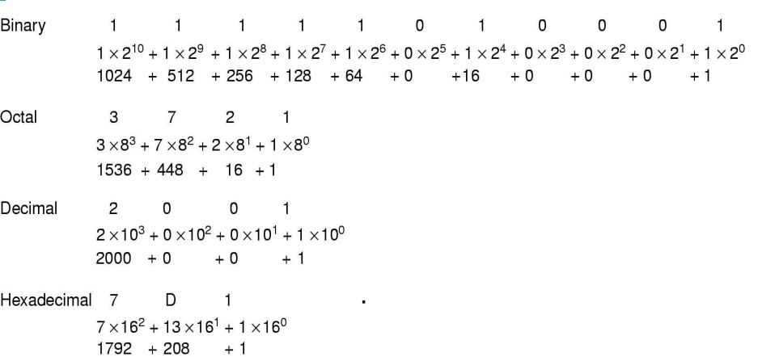
Example #1 Value of 2001 in Binary, Octal and Hexadecimal

Slide 10
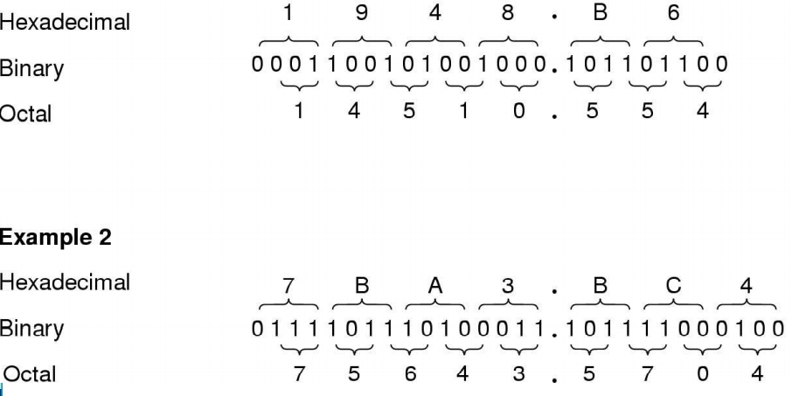
Example #2 Conversion: Binary -> Octal ->Hexadecimal

Slide 11
Decimal to Base_{N} Conversions
To convert from decimal to a different number base such as Octal, Binary or Hexadecimal involves repeated division by that number base
Keep dividing until the quotient is zero
Use the remainders in reverse order as the digits of the converted number

Slide 12
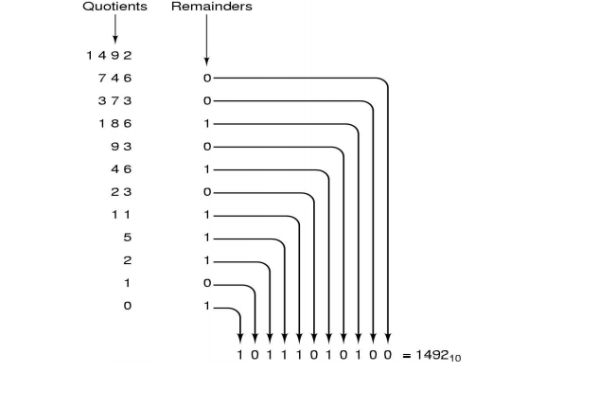
Example #3 Decimal to Binary 1492 (decimal) = ??? (binary) Repeated Divide by 2

Slide 13
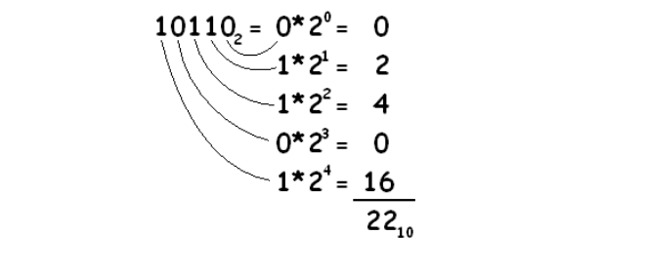
Base_{N} to Decimal Conversions
Multiply each digit by increasing powers of the base value and add the terms
Example: 101102 = ??? (decimal)

Slide 14
Data Representation
Computers store everything as binary digits. So, how can we encode numbers, images, sound, text??
We need standard encoding systems for each type of data.
Some standards evolve from proprietary products which became very popular.
Other standards are created by official industry bodies where none previously existed.

Slide 15
Alphanumeric Data
Alphanumeric data such as names and addresses are represented by assigning a unique binary code or sequence of bits to represent each character.
As each character is entered from a keyboard (or other input device) it is converted into a binary code.
Character code sets contain two types of characters:
– Printable (normal characters)
– Non-printable. Characters used as control codes.
CTRL G (beep)

Slide 16
Alphanumeric Codes
Characters are represented internally by these 8-bit binary codes.
An 8-bit memory word can thus store one character.
A 16-bit memory word is usually divided into two 8-bit segments or bytes.
Each of which can store a single character. Similarly, a 32-bit memory word can store four characters.
Character strings of length greater than the number of bytes in a word are stored in two or more consecutive words.
There are 3 main coding methods in use:
ASCII, EBCDIC ,Unicode .

Slide 17
ASCII (American Standard Code for Information Interchange)
7-bit code (128 characters)
Has an extended 8-bit version
Used on PC’s and non-IBM mainframes
Widely used to transfer data from one computer to another

Slide 18
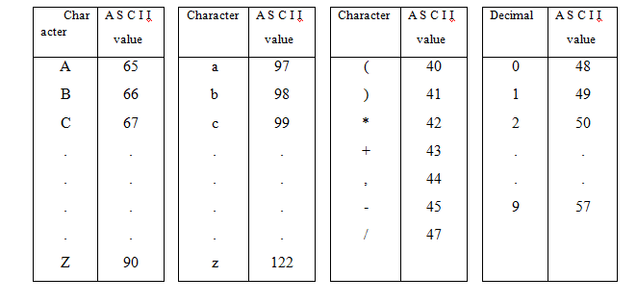
ASCII character set (Sample)

Slide 19
EBCDIC (Extended Binary Coded Decimal Interchange Code).
An 8-bit code (256 characters)
Different collating sequence to ASCII
Used on mainframe IBM machine
Both ASCII and EBCDIC are 8 bit codes inadequate for representing all international characters
– Some European characters
– Most non-Alphabetic languages
e.g Mandarin, Kanji, Arabic, etc…

Slide 20

Unicode
New 16 bit standard - can represent 65,536 characters
Of which 49,000 have been defined
– 6400 reserved for private use
– 10,000 for future expansions
Incorporates ASCII-7
Example - Java code:
char letter = ‘A’;
char word[ ] = ‘YES’;
Stores the values using Unicode characters
Java VM uses 2 bytes to store one Unicode character.

Slide 21
Numeric Data
Need to perform computations
Need to represent only numbers
Using ASCII coded digits is very inefficient
Representation depends on nature of the data and processing requirements
Display purposes only (no computations): CHAR
• PRINT 125.00
– Computation involving integers: INT
• COMPUTE 16 / 3 = 5
– Computation involving fractions: FLOAT
• COMPUTE 2.001001 * 3.012301 = 6.0276173133

Slide 22
Representing Numeric Data
Stored within the computer using one of several different numeric representation systems
Derived from the binary (base 2) number system.
We can represent unsigned numbers from 0-255 just using 8 bits
Or in general we can represent values from 0 to 2^{N} -1 using N bits.
The maximum value is restricted by the number of bits available (called Truncation or Overflow)
However, most programming languages support manipulation of signed and fractional numbers.
How can these be represented in binary form?

Slide 23
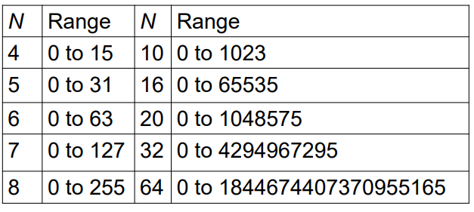
Representing Numeric Data
Range of Values 0 to 2^{N}-1 in N bits

Slide 24
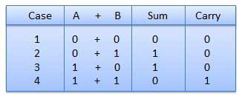
Binary Arithmetic Binary Addition
Addition in binary is precisely analogous to addition in decimal.
Working from the write, if the sum of 2 digits produces a 2 digit result, the digit on the right is written down and the digit on the left is added to the next column to the left.

Slide 25
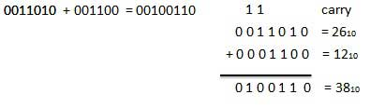
Example 1: Binary Addition
Example 2: Binary Addition
10101 and 11011 1 1 1 1 Carry overs 1 0 1 0 1 1 1 0 1 1 1 1 0 0 0 0

Slide 26
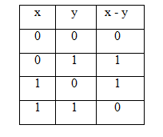
Binary Subtraction
Recall that in decimal subtraction one subtracts a decimal digit from a smaller decimal digit by borrowing 1 from the term on the left.
Binary subtraction can be accomplished similarly. The borrowed 1 and the 0 of the location involved combine to form (10)₂.
Thus, if there is a digit on the left, 0 - 1 becomes 10 -1 = 1, with a 1 borrowed from the left.

Slide 27
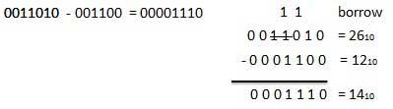
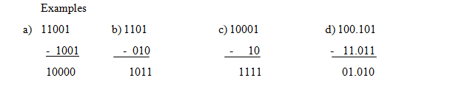
Example 1: Binary Subtraction
Example 2: Binary Subtraction

Slide 28
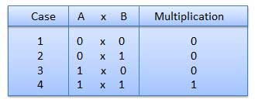
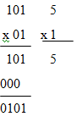
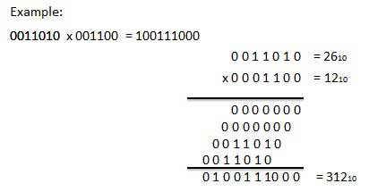
Binary Multiplication
Binary multiplication is similar to decimal multiplication.
It is simpler than decimal multiplication because only 0s and 1s are involved.
There are four rules of binary multiplication.

Slide 29
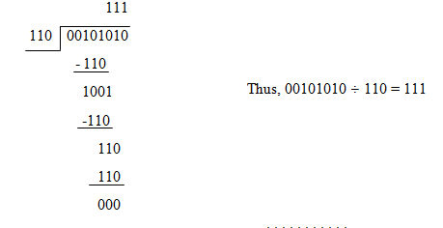
Binary Division
Binary division is similar in procedure to decimal division.
The placement of the binary point is exactly the same as the placement of the decimal point in decimal division.

Slide 30
Integer Representation
UNSIGNED representing numbers from 0 upwards or SIGNED to allow for negatives.
In the computer we only have binary digits, so to represent negative integers we need some sort of convention.
Four conventions in use for representing negative integers are:
– Sign and Magnitude
– 1’s Complement
– 2’s Complement
– Excess 128

Slide 31
Negative Integers – Sign and Magnitude
Simplest form of representation
Stores positive and negative values by dividing the “n” total bits into two parts: 1 bit for the sign and n–1 bits for the value which is a pure binary number
Example:
– +6 in 8-bit representation is: 00000110
– -6 in 8-bit representation is: 10000110
Disadvantages
– Arithmetic is difficult
– Two representations for zero
• 00000000
• 10000000

Slide 32
Negative Integers – One’s (1’s) Complement
Computers generally use a system called “complementary representation” to store negative integers.
Two basic types - ones and twos complement, of which 2’s complement is the most widely used.
Negative numbers begin with 1, positive with 0.

Slide 33
Negative Integers – One’s (1’s) Complement
To perform 1’s complement operation on a binary number, replace 1’s with 0’s and 0’s with 1’s (i.e Complement it!)
+6 represented by: 00000110
-6 represented by: 11111001
Advantages: arithmetic is easier (cheaper/faster electronics)
Fairly straightforward addition – Add any carry from the Most Significant (left-most) Bit to Least Significant (right-most) Bit of the result
For subtraction – form 1’s complement of number to be subtracted and then add
Disadvantages : still two representations for zero 00000000 and 11111111 (in 8-bit representation)

Slide 34
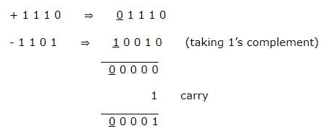
One’s Complement Example
Case I: When the positive number has greater magnitude.
Hence the required sum is + 0001.

Slide 35
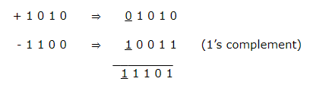
One’s Complement Example cont.
Case II: When the negative number has greater magnitude.
Hence the required sum is – 0010.

Slide 36
Negative Integers – Two’s (2’s) Complement
To perform the 2’s complement operation on a binary number
– Replace 1’s with 0’s and 0’s with 1’s (i.e. the one's complement of the number)
– Add 1
+6 represented by: 00000110
-6 represented by: 11111010
Advantages:
– Arithmetic is very straightforward
– End Around Carry is ignored
only one representation for zero (00000000)

Slide 37
Negative Integers – Two’s (2’s) Complement
Two’s Complement
–To convert an integer to 2’s complement
Take the binary form of the number
00000110 (6 as an 8-bit representation)
Flip the bits: (Find 1’s Complement)
11111001
Add 1 11111001 +1 = 11111010 (2’s complement of 6)
Justification of representation: 6+(-6)=0?
00000110 (6)
+11111010 (2’s complement of 6)
100000000 (0)

Slide 38
Negative Integers – Two’s (2’s) Complement
Properties of Two’s Complement
–The 2’s comp of a 2’s comp is the original number
00000110 (6)
11111010 (2’s comp of 6)
00000101
+1
00000110 (2’s comp of 2’s comp of 6)
–The sign of a number is given by its MSB
The bit patterns:
00000000 represents zero
0nnnnnnn represents positive numbers
1nnnnnnn represents negative number

Slide 39
Negative Integers – Two’s (2’s) Complement
•Addition
–Addition is performed by adding corresponding bits
00000111 ( 7)
+00000101 (+5)
00001100 (12)
•Subtraction –Subtraction is performed by adding the 2’s complement
–Ignore End-Around-Carry
00001100 (12)
+11111011 (-5)
100000111 ( 7)

Slide 40
Negative Integers – Two’s (2’s) Complement
•Interpretation of Negative Results
00000101 ( 5)
+11110100 (-12)
11111001 ( )
–Result is negative
MSB of result is 1 so it is a negative number in 2’s complement form
–Negative what?
Take the 2’s comp of the result to find out since the 2’s comp of a 2’s comp is the original number
–Negative 7 the 2’s complement of 11111001 is 00000111 or 7₁₀

Slide 41
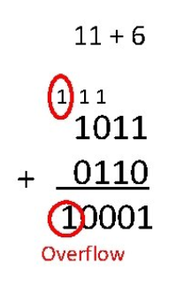
Integer Overflow
Problem: A result of an artihematic operation that is too big to be represented in number of bits available. This is called overflow.
Overflow can occur whether or not there is a carry
Example:

Slide 42
Basics of digital logic gates and Boolean algebra
Binary (Boolean) Logic deals with binary variables and binary logic functions has two discrete values
0 -> False, Open
1 -> True, Close
Three basic logical operations
AND (.); OR (+); NOT (‘)

Slide 43
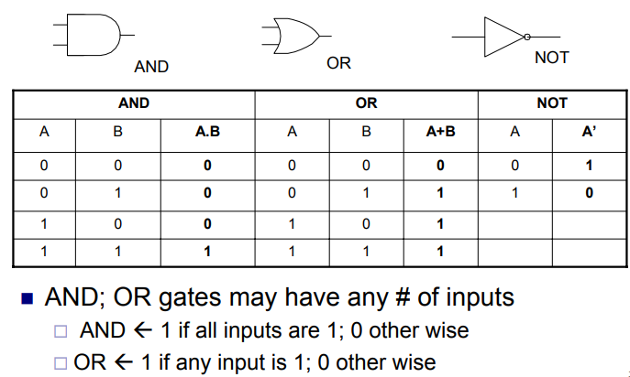
Logic Gates & Truth Tables

Slide 44
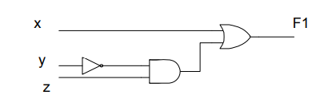
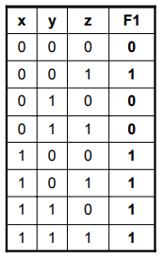


Slide 45
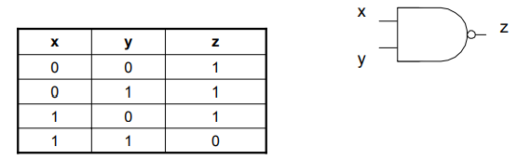
Other Logic Gates – NAND Gate
2-input NAND (NOT-AND operation)
Can have any # of inputs

Slide 46
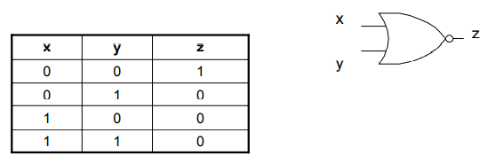
Other Logic Gates – NOR Gate 
2-input NOR (NOT-OR operation)
Can have any # of inputs

Slide 47
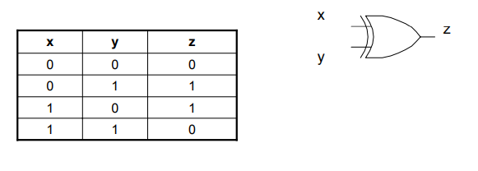
Other Logic Gates – XOR Gate
2-input XOR Output is 1 if any input is one and the other input is 0
Can have any # of inputs

Slide 48
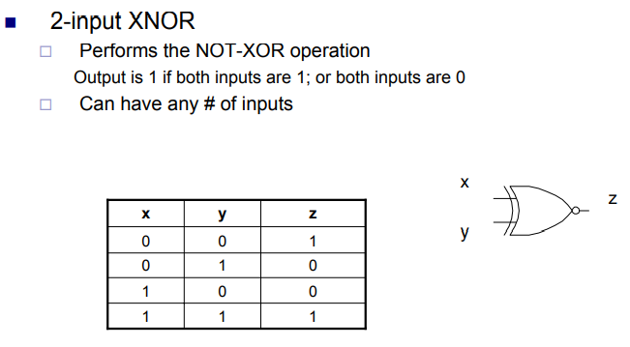
Other Logic Gates – XNOR Gate

Slide 49
Introduction to computer organization and Architecture.
Why study computer organization and architecture?
Design better programs, including system software such as compilers, operating systems, and device drivers.
Optimize program behavior.
Evaluate (benchmark) computer system performance.
Understand time, space, and price tradeoffs.

Slide 50
Computer organization
physical aspects of computer systems.
E.g., circuit design, control signals, memory types.
How does a computer work?
Computer architecture
Logical aspects of system as seen by the programmer.
E.g., instruction sets, instruction formats, data types, addressing modes.
How do I design a computer?

Slide 51
At the most basic level, a computer is a device consisting of three pieces:
A processor to interpret and execute programs
A memory to store both data and programs
A mechanism for transferring data to and from the outside world.

Slide 52
The Computer Level Hierarchy Level Hierarchy
Writing complex programs requires a “divide and conquer” approach, where each program module solves a smaller problem.
Complex computer systems employ a similar technique through a series of virtual machine layers.

Slide 53
…. Cont
Each virtual machine layer is an abstraction of the level below it.
The machines at each level execute their own particular instructions, calling upon machines at lower levels to perform tasks as required.
Computer circuits ultimately carry out the work.

Slide 54
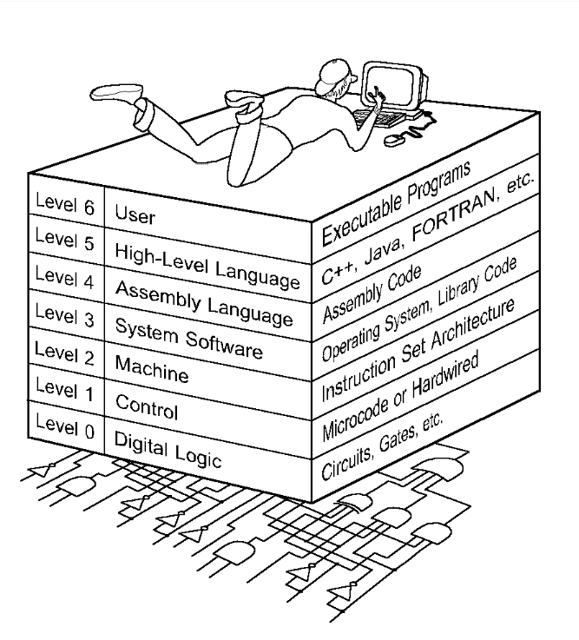

Slide 55
…….cont
Level 6: The User Level
Program execution and user interface level.
The level with which we are most familiar.
Level 5: High-Level Language Level
The level with which we interact when we write programs in languages such as C, Pascal, Lisp, and Java.

Slide 56
……cont
Level 4: Assembly Language Level
Acts upon assembly language produced from Level 5, as well as instructions programmed directly at this level.
Level 3: System Software Level
Controls executing processes on the system.
Protects system resources.
Assembly language instructions often pass through Level 3 without modification.

Slide 57
……cont
Level 2: Machine Level
Also known as the Instruction Set Architecture (ISA) Level.
Consists of instructions that are particular to the architecture of the machine.
Programs written in machine language need no compilers, interpreters, or assemblers.

Slide 58
……cont.
Level 1: Control Level
A control unit decodes and executes instructions and moves data through the system.
Control units can be micro-programmed or hardwired.
A micro-program is a program written in a low-level language that is implemented by the hardware.
Hardwired control units consist of hardware that directly executes machine instructions.

Slide 59
…….cont
Level 0: Digital Logic Level
This level is where we find digital circuits (the chips).
Digital circuits consist of gates and wires.
These components implement the mathematical logic of all other levels.

